Slide 1



UNIVERSITY INSTITUTE OF ENGINEERING
COMPUTER SCIENCE ENGINEERING
Bachelor of Engineering
Design and Analysis of Algorithms(CST-311/ITT-311)
Topic: Divide and Conquer
DISCOVER . LEARN . EMPOWER

Slide 2
Learning Objectives & Outcomes
Objective:
To understand the concept of Divide and conquer and how to solve binary search and min max problem using divide and conquer problem.
Outcome:
Student will understand
Divide and Problem
Binary Search
Min max Problem

Slide 3
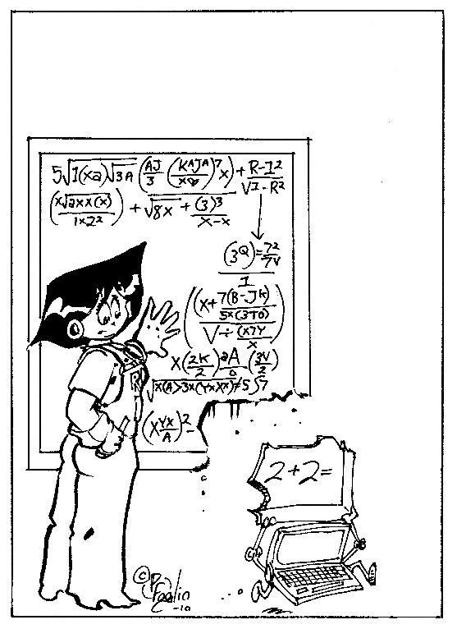
Divide and Conquer
Breaking large problems into smaller subproblems.
Binary Search
Max-Min Problem
Merge Sort

Slide 4
Divide and Conquer
The common theme for the previous slides: iterate over every location in the list
The common theme for this chapter’s slides: divide and conquer
  break a problem into smaller pieces and solve the smaller sub-problems
It may not seem like that big a deal, but the improvement can be dramatic
  approximate number of comparisons (worst case):

Slide 5

search
 | n = 100 | n = 1,000
search | 100 | 1,000
bsearch | 7 | 10
sort
 | n = 100 | n = 1,000
isort | 5,000 | 500,000
msort | 700 | 10,000

Slide 6

Searching a Dictionary
To get a general sense of how the divide
and conquer strategy improves search,
consider how people find information in
a phone book or dictionary
  suppose you want to find “janissary” in
  a dictionary
  open the book near the middle
  the heading on the top left page is “kiwi”,
  so move back a small number of pages
  here you find “hypotenuse”, so move forward
  find “ichthyology”, move forward again
The number of pages you move gets
smaller (or at least adjusts in response
to the words you find)

Slide 7
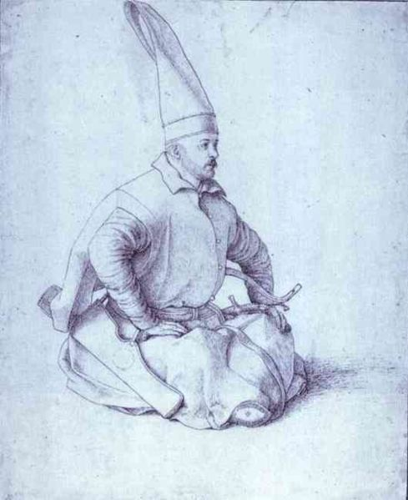
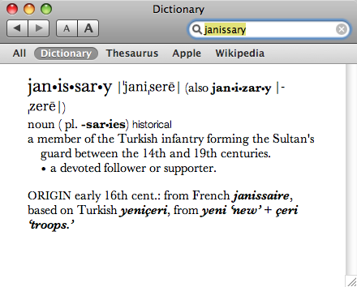
Searching a Dictionary
A detailed specification of this process:
the goal is to search for a word w in region of the book
the initial region is the entire book
at each step pick a word x in the middle of the current region
there are now two smaller regions: the part before x and the part after x
if w comes before x, repeat the search on the region before x, otherwise search the region following x (go back to step 3)
Note: at first a “region” is of a group of pages,
but eventually a region is a set of words on
a single page

Slide 8

Binary Search
The binary search algorithm uses the divide-and-conquer strategy to search through an array
The array must be sorted
  the “zeroing in” strategy for looking up a
  word in the dictionary won’t work it the
  words are not in alphabetical order
  binary search will not work unless the
  array is sorted

Slide 9
Binary Search (Contd.)
Problem:
Binary search can be performed on a sorted array. In this approach, the index of an element x is determined if the element belongs to the list of elements.
Solution:
In this algorithm, we want to find whether element x belongs to a set of numbers stored in an array numbers[ ]. Where l and r represent the left and right index of a sub-array in which searching operation should be performed.

Slide 10
Algorithm
Algorithm: Binary-Search(numbers[ ], x, l, r)
if l = r then
return l
else
m := ⌊(l + r) / 2⌋
if x ≤ numbers[m] then
return Binary-Search(numbers[ ], x, l, m)
else
return Binary-Search(numbers[ ], x, m+1, r)

Slide 11
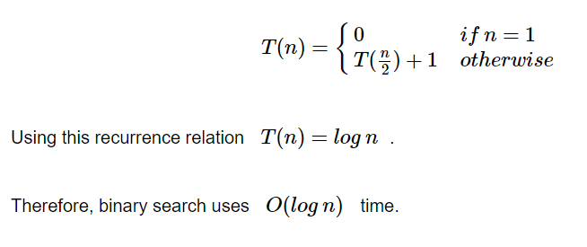
Analysis of Binary Search
Linear search runs in O(n) time. Whereas binary search produces the result in O(log n) time
Let T(n) be the number of comparisons in worst-case in an array of n elements.
Hence,

Slide 12
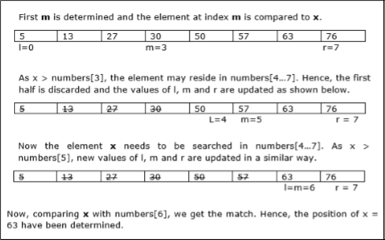
Example
In this example, we are going to search element 63.

Slide 13
Max-Min Problem
Problem Statement
The Max-Min Problem in algorithm analysis is finding the maximum and minimum value in an array.
Solution
To find the maximum and minimum numbers in a given array numbers[ ] of size n, the following algorithm can be used. First we are representing the naive method and then we will present divide and conquer approach.

Slide 14
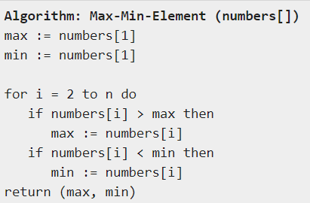
Naïve Method
Naïve method is a basic method to solve any problem. In this method, the maximum and minimum number can be found separately. To find the maximum and minimum numbers, the following straightforward algorithm can be used.

Slide 15
Analysis of Naïve Method
The number of comparison in Naive method is 2n - 2.
The number of comparisons can be reduced using the divide and conquer approach. Following is the technique.

Slide 16
Divide and Conquer Approach
In this approach, the array is divided into two halves. Then using recursive approach maximum and minimum numbers in each halves are found. Later, return the maximum of two maxima of each half and the minimum of two minima of each half.

Slide 17
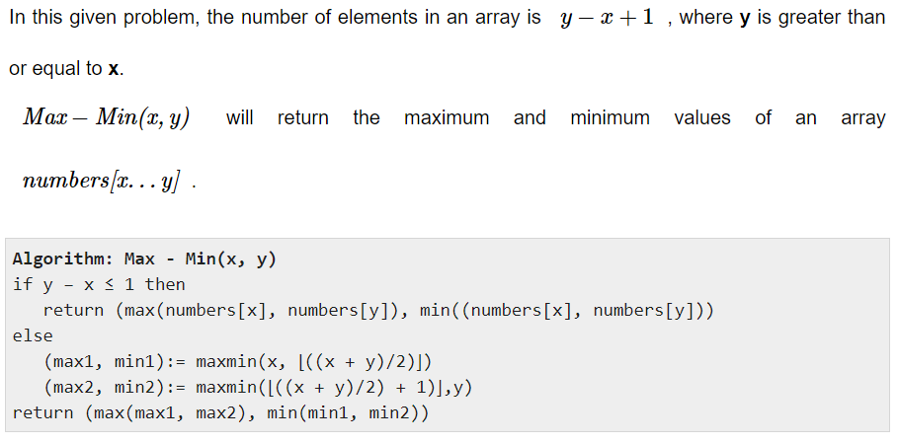

Slide 18
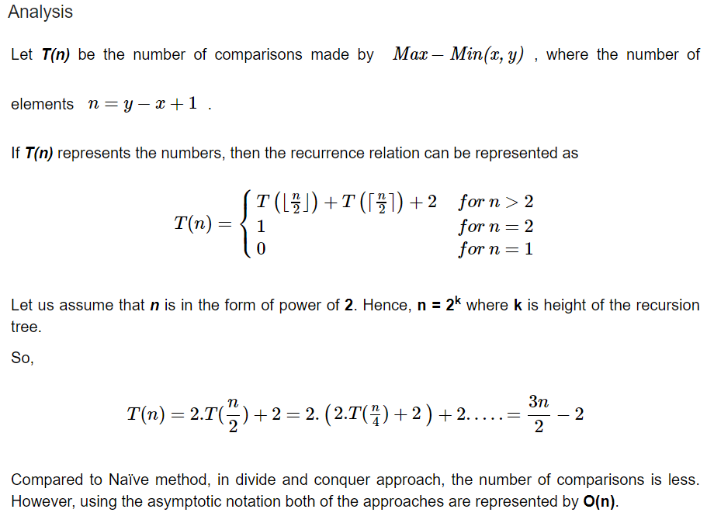

Slide 19
REFERENCES
Text books:
Cormen, Leiserson, Rivest, Stein, “Introduction to Algorithms”, Prentice Hall of India, 3rd edition 2012. problem, Graph coloring.
Websites:
https://www.tutorialspoint.com/design_and_analysis_of_algorithms/design_and_analysis_of_algorithms_max_min_problem.htm
https://www.tutorialspoint.com/design_and_analysis_of_algorithms/design_and_analysis_of_algorithms_binary_search.htm

Slide 20
Summary
  Divide and Conquer:
    Concept of Divide and conquer
    Binary Search
    Min Max Problem

Slide 21
THANK YOU

